Slide 1
Web Technologies: Introduction
ICT40120 Certificate IV in Information Technology (Programming)
Code | Title
ICTWEB441 | Produce basic client-side script
ICTWEB452 | Create a markup language document

Slide 2
Overview
This sessions may include:
Semantic HTML
HTML Validation
Challenges
Out of class activities

Slide 3
Semantic HTML & Validating

Slide 4
Semantic HTML
This is HTML that adds meaning to the content
It utilizes Semantic HTML Elements
They include:
h1 – h6 header main
nav footer article
aside section

Slide 5
Simple Semantic HTML Demo
Let’s use some of these and create a demo
We will use WebStorm
The project will keep each session in a folder
We provide the base structure...

Slide 6
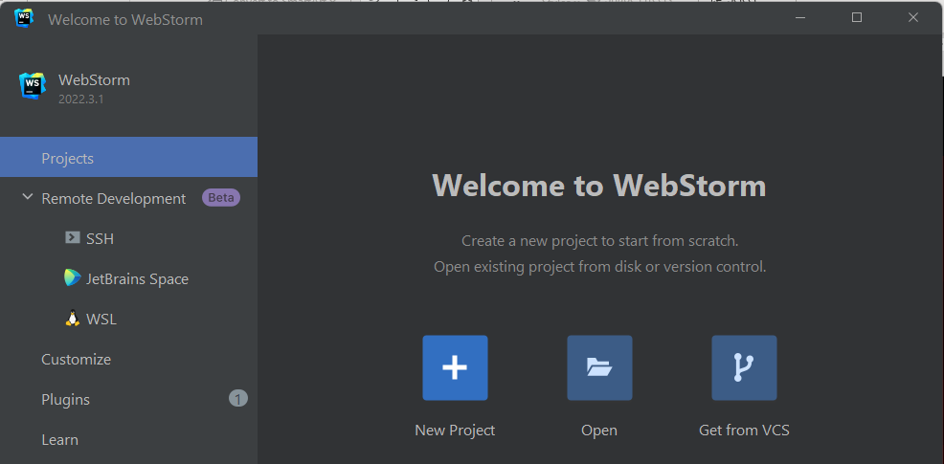
Simple Semantic HTML Demo
Open WebStorm
You should see this if it the first time you have opened it, or you have no projects open
Click New Project

Slide 7
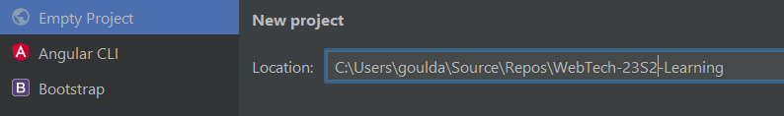
Simple Semantic HTML Demo
In the Empty Project option, the right side will show a location.
Edit the location after C:\Users\YOUR_USER_ID\
Type in:
Source\Repos\WebTech-23S2-Learning
The picture shows Adrian Gould’s entry:

Slide 8
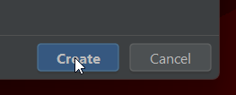
Simple Semantic HTML Demo
Click the Create button
The folders are automatically created!

Slide 9
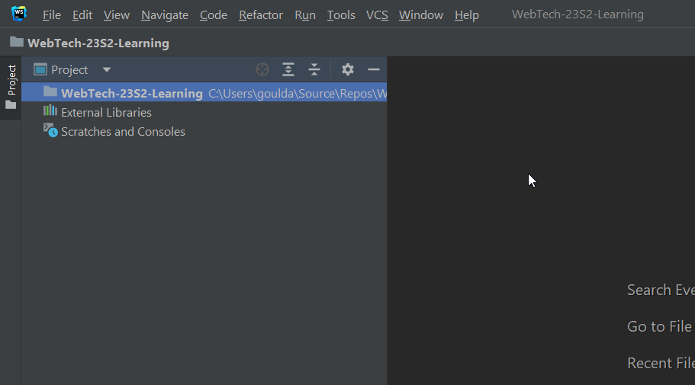
Simple Semantic HTML Demo
You will then be presented with the WebStorm IDE

Slide 10
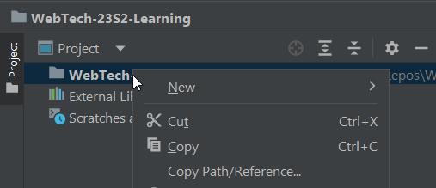
Simple Semantic HTML Demo
Point to and right click the WebTech-23S2-Learning under “Project”.

Slide 11
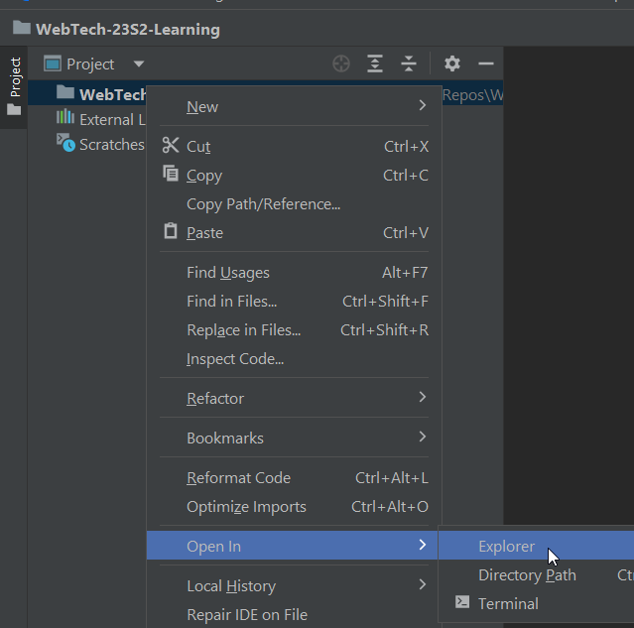
Simple Semantic HTML Demo
Move the mouse down and over Open In
Hover over and click Explorer
This opens a Windows File Explorer window.

Slide 12

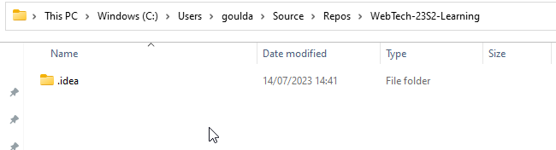
Simple Semantic HTML Demo
Double click the Folder to open it.
You will see a folder named .idea
This contains the WebStorm configuration for the project
Do not delete it under normal situations

Slide 13
Simple Semantic HTML Demo
Go to Blackboard and locate Session 3 in the Learning Materials
Locate the Session Files
Download the WebTech-yySn-Learning.zip or WebTech-yySn-Learning.7z file
This contains the base folders and files for the semester.

Slide 14
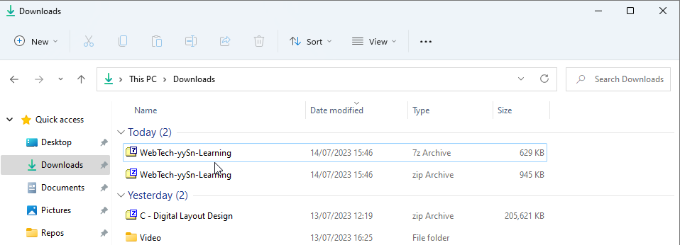
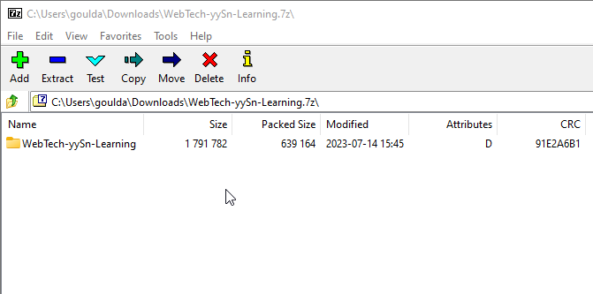
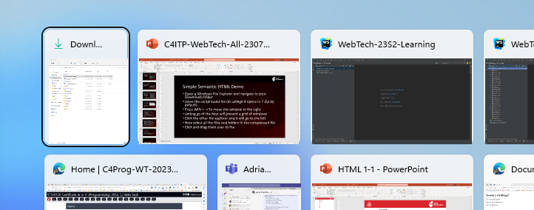
Simple Semantic HTML Demo
Open a Windows File Explorer and navigate to your Downloads folder
Open the compressed file
Press WIN → To move the window to the right
Letting go of the keys will present a grid of windows
Click the other file explorer and it will go to the left

Slide 15
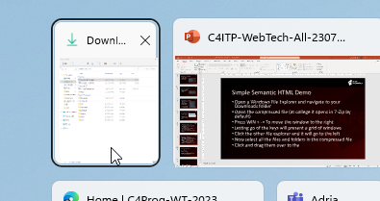

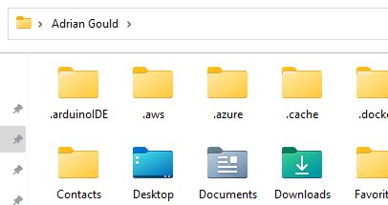
Simple Semantic HTML Demo
Click the other file explorer and it will go to the left
Click in the area that says “This PC”
Delete any text and type in %userprofile% and press ENTER
This will open your User folder

Slide 16
Simple Semantic HTML Demo
Double Click Source
Double Click Repos
Finally, Double click the project name
In the 7-Zip window, double click the WebTech-yySn-Learning folder to show all the files

Slide 17
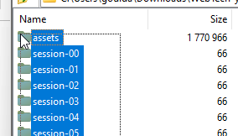

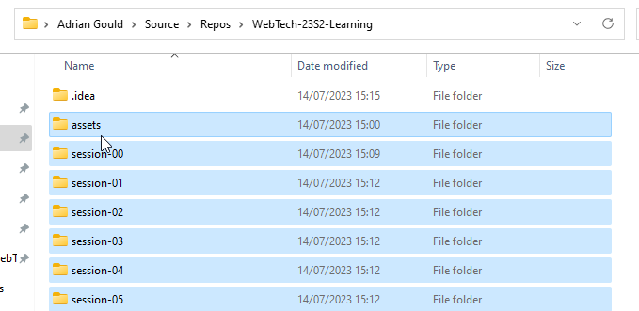
Simple Semantic HTML Demo
Now select all the files and folders in the compressed file
Click and drag them over to the WebTech-23S2-Learning folder
Letting the mouse button go will copy the files into the desired location

Slide 18
Simple Semantic HTML Demo
We are ready to go...
Make sure you now have WebStorm as your main window
We suggest maximising it

Slide 19

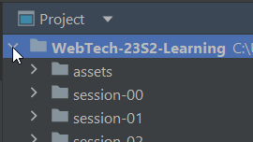


Simple Semantic HTML Demo
Click the symbol next to the Project Name
This shows a list of folders
Click the same symbol next to session-01
This shows the folders and files in session-01

Slide 20

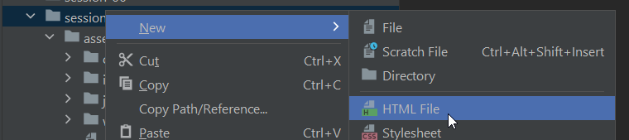
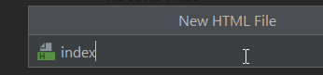
Simple Semantic HTML Demo
Right Click on the session-01 folder name
Hover over New
Move and hover over HTML File
Let go of the mouse button
In the new HTML file dialog…
Type in index and press ENTER

Slide 21
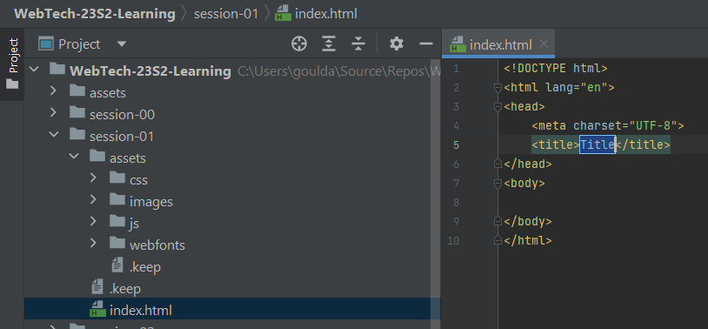
Simple Semantic HTML Demo
You will then be presented with a part of the IDE on the right
This is the Editor
Note: the file has automatically added .html

Slide 22
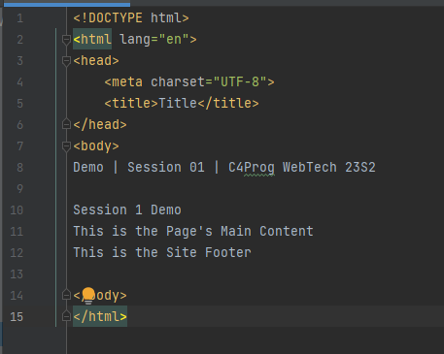
Simple Semantic HTML Demo
Now we will add some content
Open the demo.txt file (look in assets/documents)
Copy the file content
Paste into the gap between <body> and </body>

Slide 23

Simple Semantic HTML Demo
View the content using a browser
Do this by:
Hovering over the Editor area
A list of browser icons will appear
Click on Chrome or Edge
This opens the file in “live view”

Slide 24
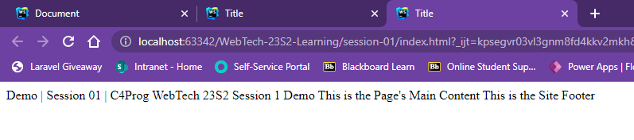
Simple Semantic HTML Demo
You should see:

Slide 25
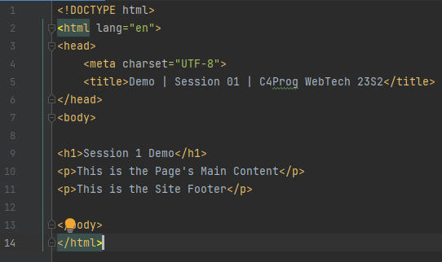
Simple Semantic HTML Demo
Edit the HTML file.
The title element now contains:
Demo | Session 01 | C4Prog WebTech 23S2
The Session 3 Demo will be surrounded by the h1 element:
<h1> and </h1> tags
The next two lines will be paragraphs:
<p> and </p> around each line

Slide 26
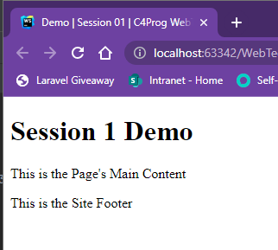
Simple Semantic HTML Demo
Press CTRL + S to save the file
Swap to the web browser
You should see the web browser has updated

Slide 27
HTML Validation
ICT40120 Certificate IV in Information Technology (Programming)

Slide 28
HTML Code Validation
It is important to validate your code
We do this in TWO ways
Using WebStorm
Using the HTML Validation Service

Slide 29
HTML Code Validation
Using the HTML Validation Service
(Copy and Paste Code)

Slide 30
HTML Code Validation
Using the HTML Validation Service
(Upload File)

Slide 31
HTML Code Validation
Using the HTML Validation Service
(Point at Web Site + File URI)

Slide 32
Session 3 Challenge 1
ICT40120 Certificate IV in Information Technology (Programming)

Slide 33
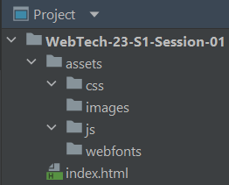
Challenge 1
Open WebStorm
Create a new Web Site Project called:
WebTech-23-S1-Session-01
Once you have done this, create the folders as shown on the right

Slide 34
Session 3 Challenge 2
ICT40120 Certificate IV in Information Technology (Programming)

Slide 35
Challenge 2
In the Root of the site, create a new web page.
Call the file:
index.html

Slide 36
Session 3 Challenge 3
ICT40120 Certificate IV in Information Technology (Programming)

Slide 37
Challenge 3
Open the new index.html page
Delete the content 😲
Now type in
html:5
Press the TAB key immediately after the 5
You have created a new HTML 5 file with all the bits you need for the next challenge...

Slide 38
Session 3 Challenge 4
ICT40120 Certificate IV in Information Technology (Programming)

Slide 39
Challenge 4
Change the title to be
Session 3 Challenge
In the body add the following entities in the correct order:
footer
header
main
nav

Slide 40
Session 3 Challenge 5
ICT40120 Certificate IV in Information Technology (Programming)

Slide 41
Challenge 5
Add the following to the structural elements:
In the header add a heading level 1 with the text:
Session 3 Challenge!
In the navigation area add the text:
This is the Site Navigation

Slide 42
Session 3 Challenge 6
ICT40120 Certificate IV in Information Technology (Programming)

Slide 43
Challenge 6
In the main add a paragraph with the text:
This is the Page’s Main Content.
In the footer add a paragraph with the text:
This is the Site Footer.

Slide 44
Session 3 Challenge 7
ICT40120 Certificate IV in Information Technology (Programming)

Slide 45
Challenge 7
Open the web page in at least TWO browsers:
For example a combination of:
Firefox and Chrome
Opera and Edge
Edge and Firefox
Compare with the images on the following slide…

Slide 46
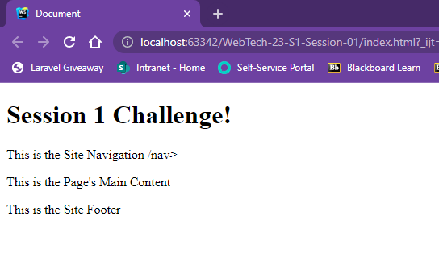
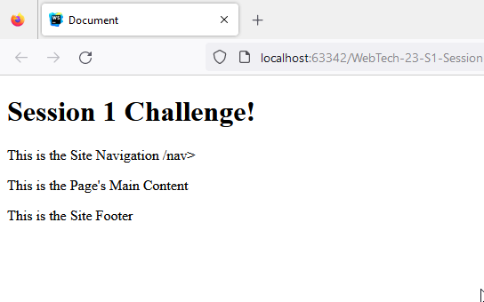
Challenge 7
Chrome
Firefox

Slide 47
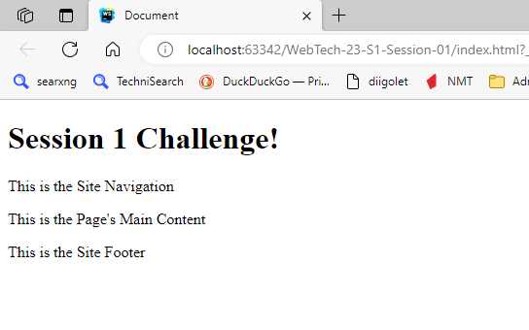
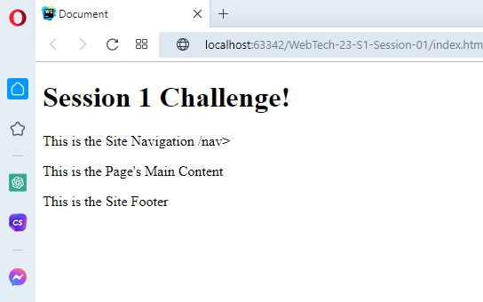
Challenge 7
Edge
Opera

Slide 48
Session 3 Challenge 8
ICT40120 Certificate IV in Information Technology (Programming)

Slide 49
Challenge 8
Did you see a problem with most of the sample screen captures?

Slide 50
Session 3 Challenge 9
ICT40120 Certificate IV in Information Technology (Programming)

Slide 51
Challenge 9
Use the W3C HTML Validation tool to make sure that the HTML is correct.
What problems did it indicate?

Slide 52
🦆

